Slide 1
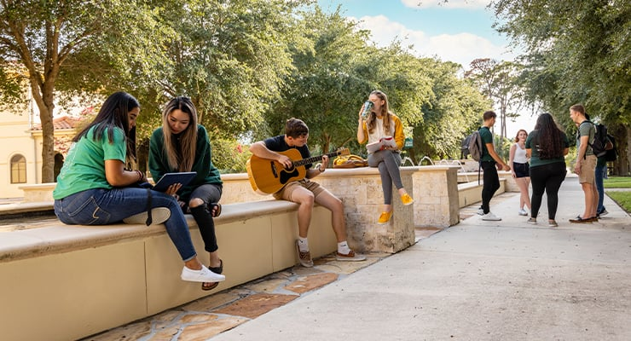
Lost & Found
Project
A Digital Solution for College Community
Item Recovery
Mentor:
Team Members:
Akhilandeswari. A
Negha S
Nideesh Kumar
Suramya Biswas

Slide 2
PRESENTATION OVERVIEW
Agenda
01
Project Introduction
05
Admin Dashboard
Problem statement and solution overview
Management controls and features
02
Technology Stack
06
Student Dashboard
Complete technical architecture overview
User interface and functionality
03
Implemented Modules
07
Future Enhancements
Core functional components breakdown
Planned improvements and expansion
04
Project Outcomes
08
Conclusion
Results and impact analysis
Summary and acknowledgments

Slide 3
PROJECT OVERVIEW
Introduction
Our Mission
To create a seamless, efficient, and community-driven lost and found system that helps students recover their belongings quickly while fostering a culture of honesty and mutual support within the college community.
The Problem
Students frequently lose personal belongings on campus, causing stress and financial burden.
24/7
Student
Instant
Availability
Community
Connection
The Solution
A digital platform that connects students who have lost items with those who have found them.

Slide 4




TECHNICAL ARCHITECTURE
Technology Stack
Frontend
Backend
Database
HTML5
Java
MySQL
Structure & Semantics
Runtime Environment
Relational DB
CSS3
Spring Boot
Styling & Responsive
Web Framework
Git Hub
Storage
Bootstrap
Spring security
Responsiveness
Secure Authentication
LocalStorage
React
Apache tomcat server
Client Data
UI Components
Web server
Socket.IO
Responsive
HTTPS
Real-time Chat
All Devices
Secure Protocol

Slide 5
SYSTEM ARCHITECTURE
Implemented Modules
Lost Item Posting
Found Item Reporting
Item Matching System
Students can create detailed posts for lost items with descriptions, photos, and location details.
Students can report found items with photos and descriptions to help locate the owners.
Intelligent matching algorithm connects lost and found items based on similarities.
Real-time Chat
Admin Management
Found Item Posting
Integrated messaging system allows direct communication between students for coordination.
Comprehensive admin panel for user management, content moderation, and system monitoring.
Students can create detailed posts for Found items with location,
Analytics Dashboard
Advanced Search
Track system performance and user engagement with detailed reporting
Powerful search capabilities for quick item discovery

Slide 6
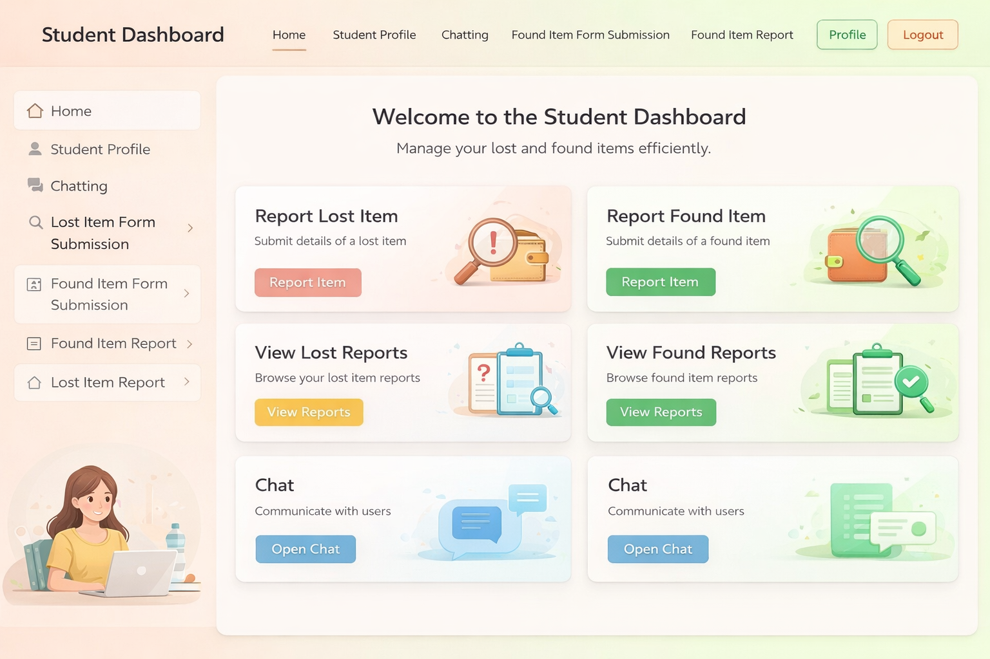
USER INTERFACE
Student Dashboard
Profile Management
Welcome
My Items
Personal Information
[Student Name]
7
Name, email, student ID, department
Password Settings
Secure password change options
Community Chat
Student can chat with others
My Item History
Lost Items
Items you've reported lost
4
Found Items
Items you've reported found
Successful Matches
Items recovered or returned
Report Found
Messages
t Lost

Slide 7
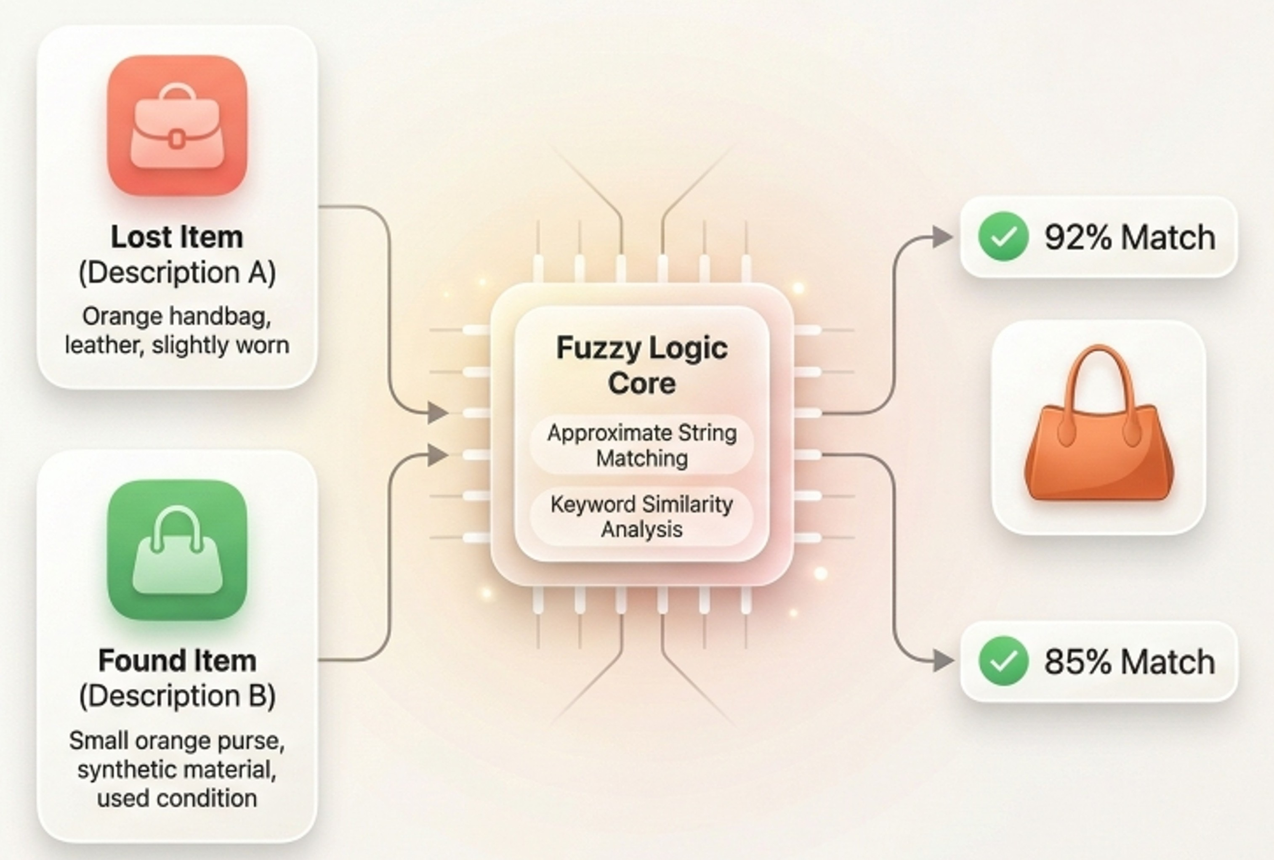
Fuzzy Matching System
Approximate Matching
Total Students
Active Items
1,247
Matches items even if descriptions are not exactly same
Handle spelling changes and similar words
89
Keyword Similarity
Compares important words like color , type , and material
Gives more importance to relevant keywords

Slide 8
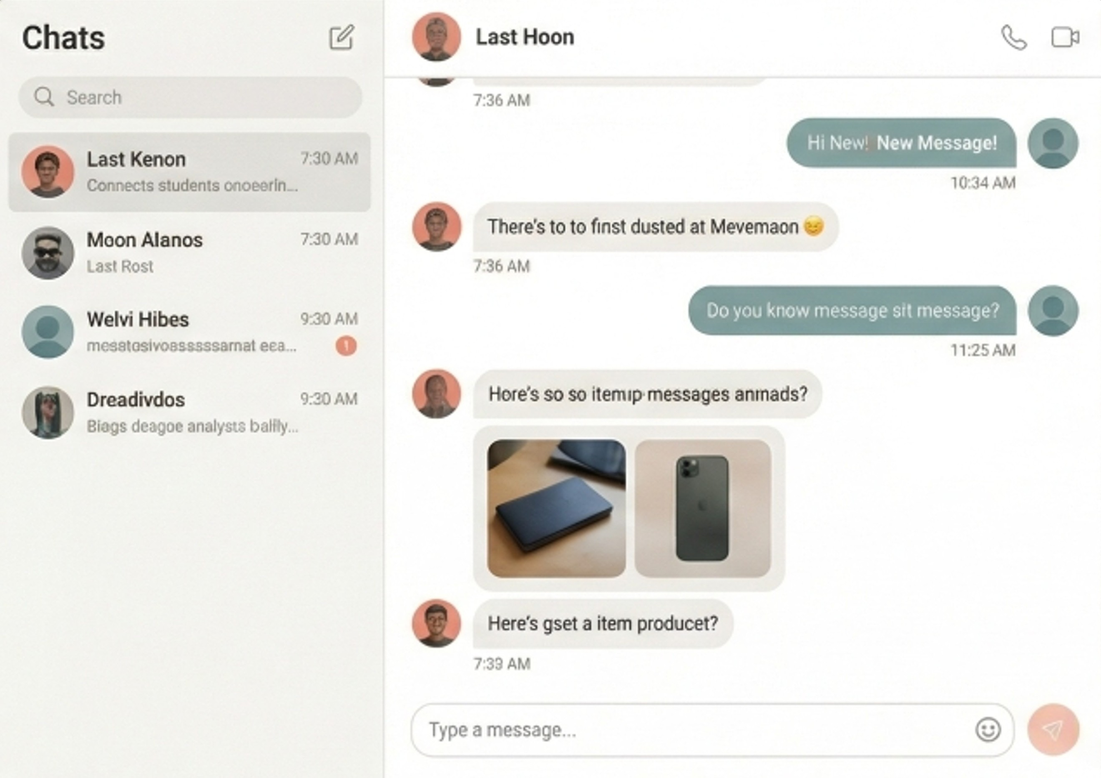
Real-Time Chat Messaging
Multi- User Communication
Total Students
Active Items
Allows Students to chat with each other instantly
Support One-to-One and group conversations
1,247
89
Secure & Easy Sharing
Chat messages are private and secure
Users can share item details
Helps in faster item identification and confirmation

Slide 9
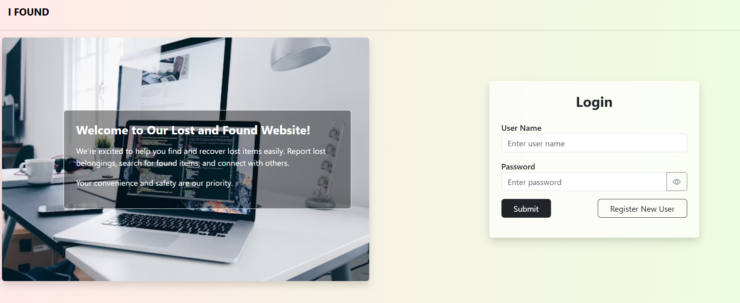
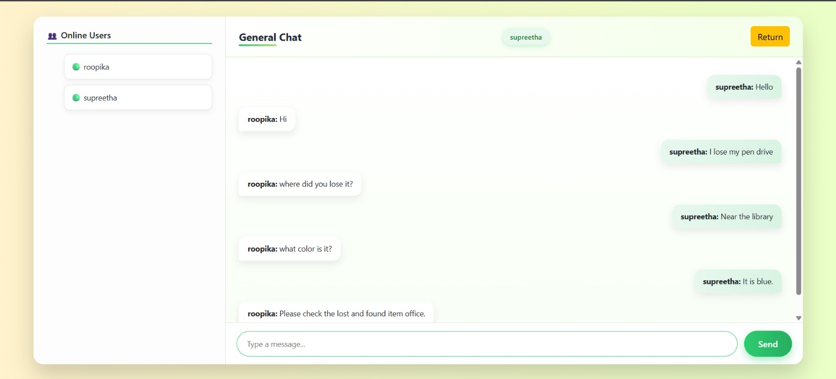
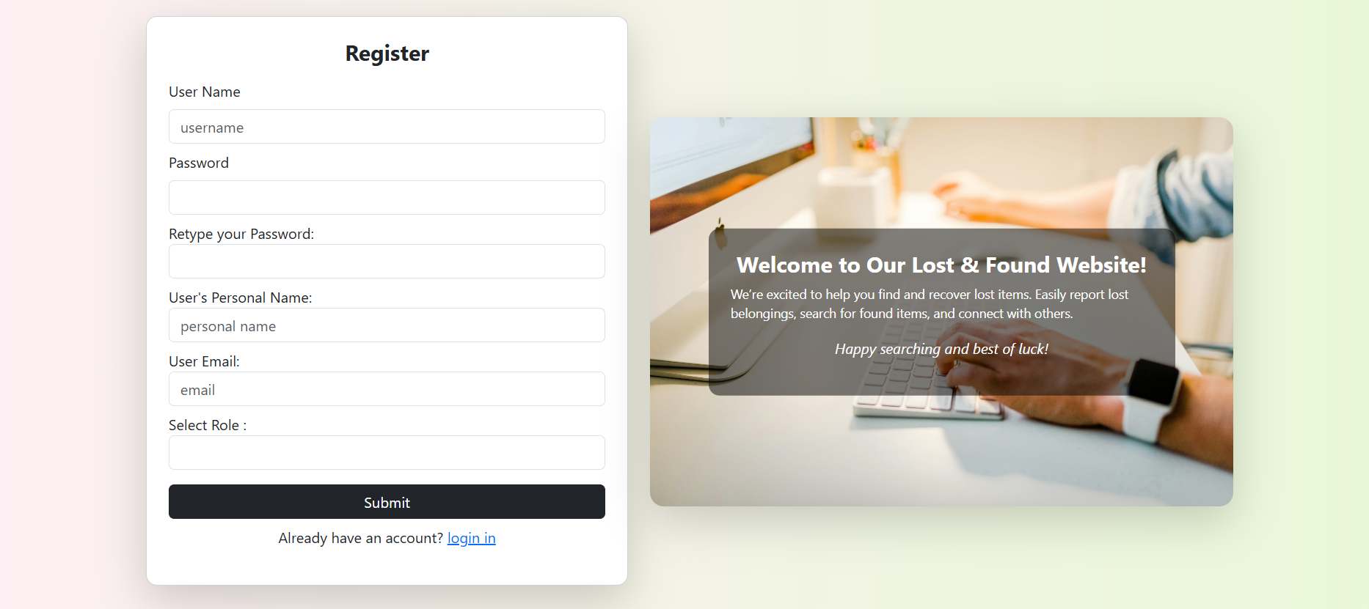
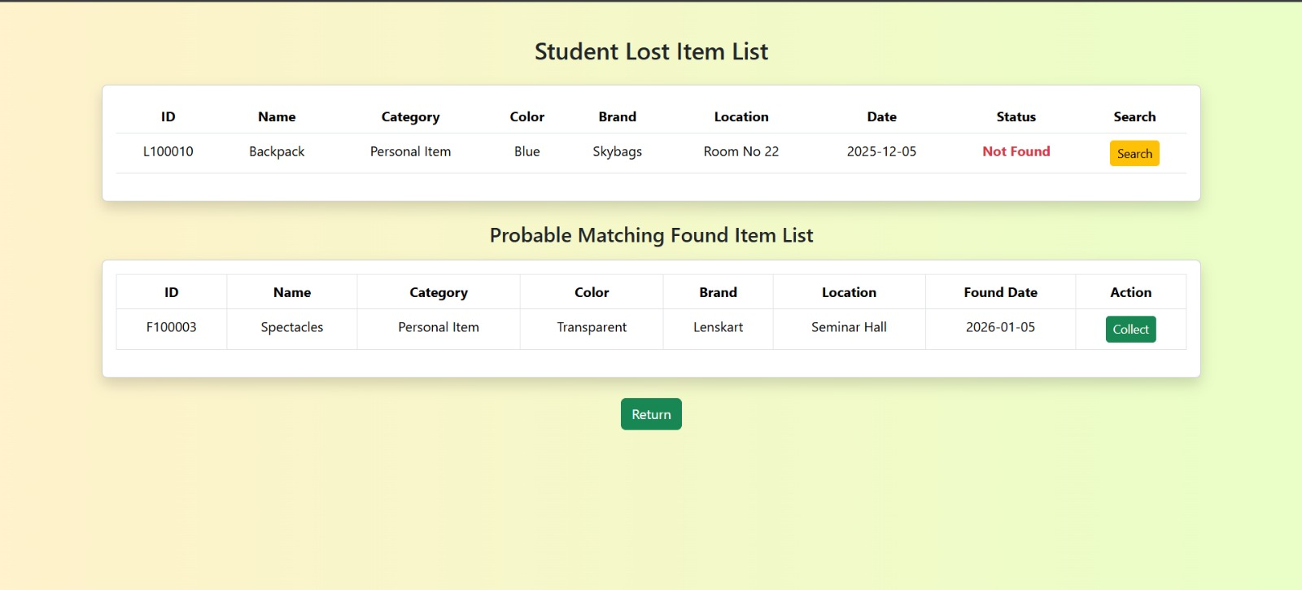
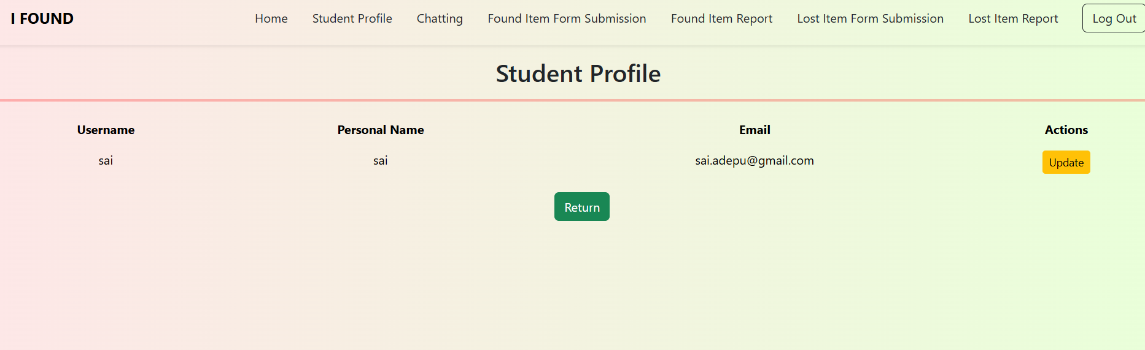
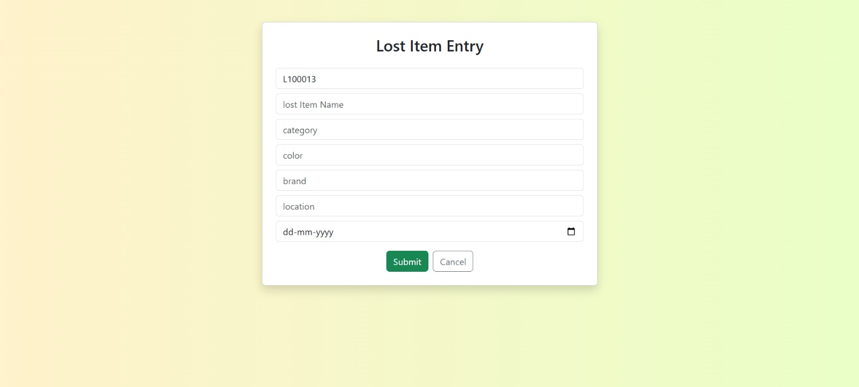
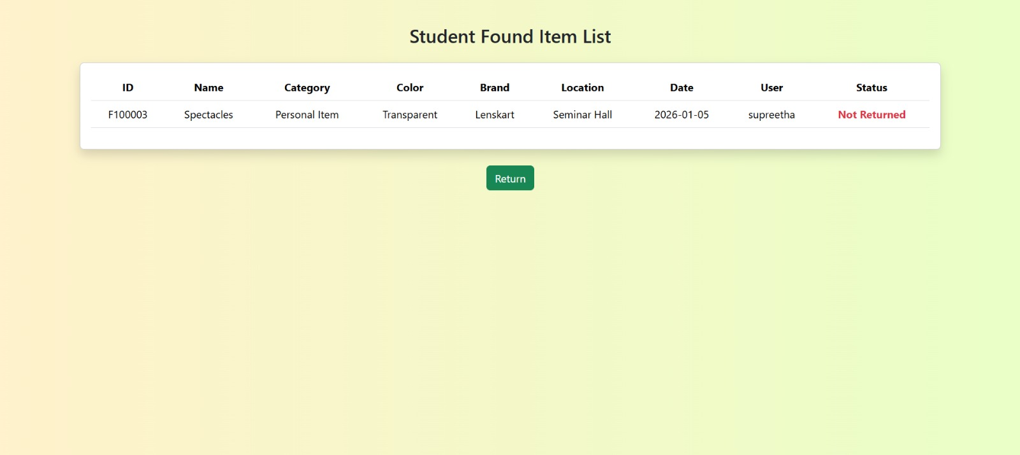
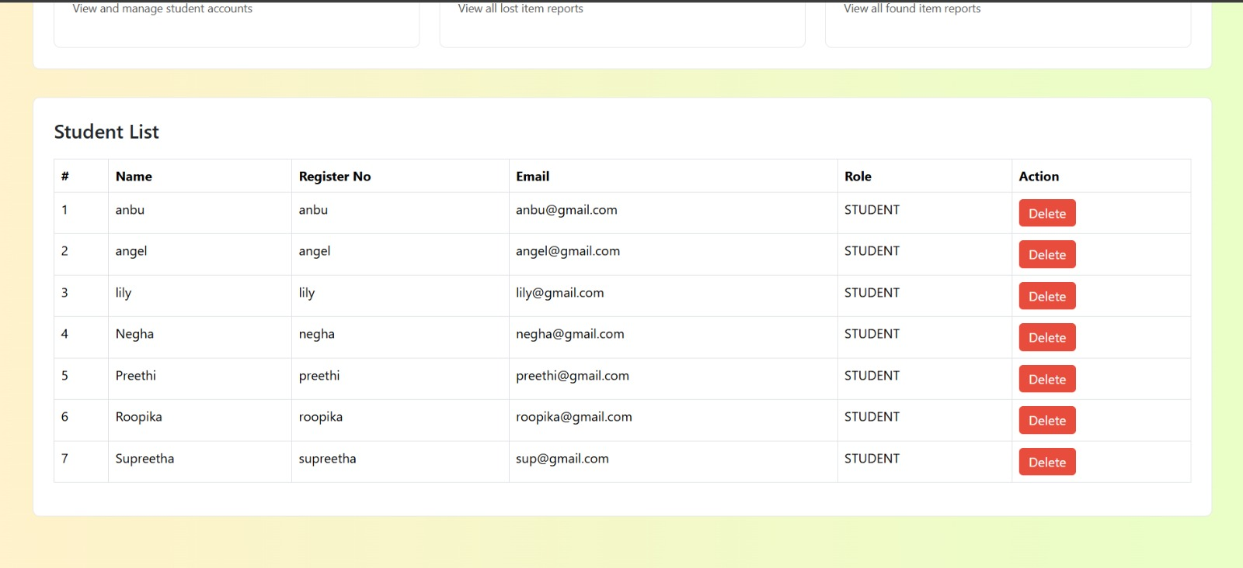
Project In Action

Slide 10
Project In Action

Slide 11
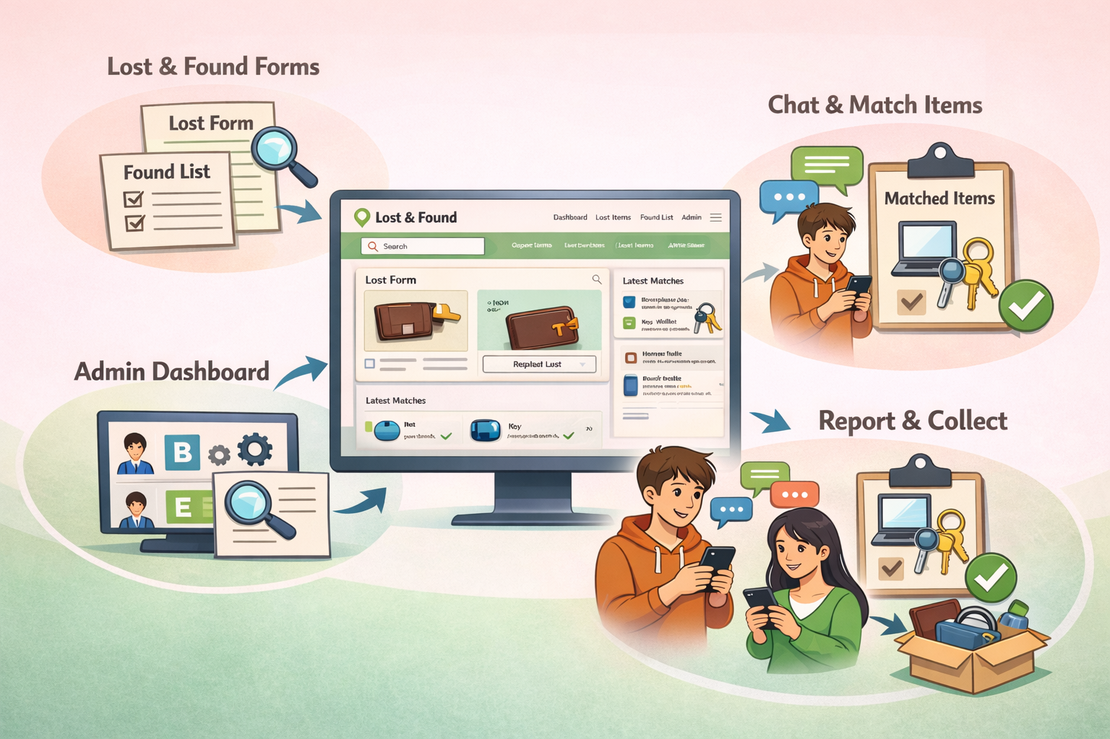
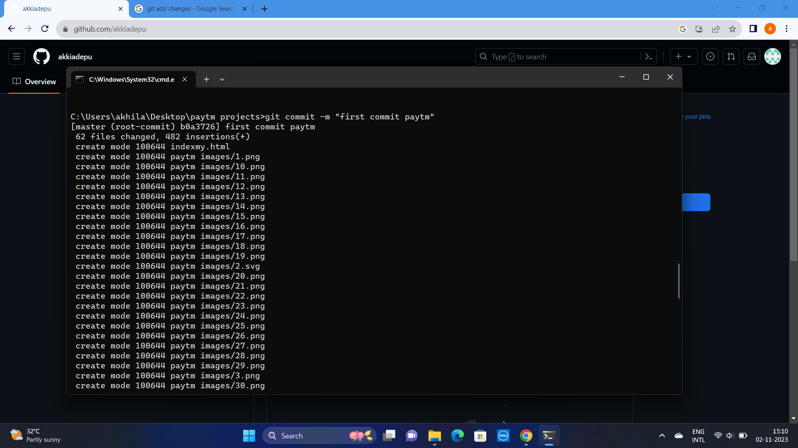
RESULTS & IMPACT
Project Outcomes
Key Achievements
150+
800+
85%
Reduced Recovery Time: Average recovery time decreased from 5 days to 3 days
Successful Recoveries
Active Users
Success Rate
User Engagement: 90% of registered students actively use the platform
Community Building: Fostered a culture of honesty and mutual support
Operational Efficiency: Streamlined the entire lost & found process
4.8/5
System Performance
User Satisfaction
Continuously monitoring and improving platform efficiency

Slide 12
ROADMAP & VISION
Future Enhancements
Mobile Application
AI-Powered Matching
Image Recognition
Native iOS and Android apps for better accessibility and push notifications.
Machine learning algorithms for intelligent item matching based on descriptions and images.
Computer vision technology to automatically categorize and identify items from photos.
Technical Improvements
Community Features
Push Notifications
Reputation System
Real-time alerts for matches and messages
Rating system for reliable users
Campus ID Integration
Achievement Badges
Seamless authentication with student IDs
Gamification to encourage participation
Advanced Analytics
Social Sharing
Detailed reporting and insights dashboard
Share listings on social platforms
Our Vision
To create the most comprehensive and user-friendly lost & found ecosystem for educational institutions worldwide.

Slide 13
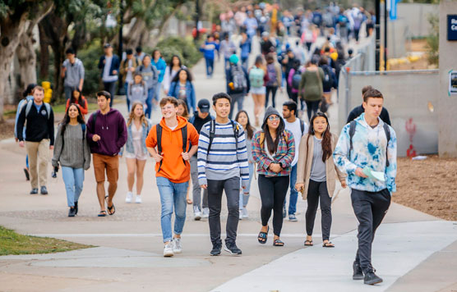
Thank You
Project Conclusion
The Lost & Found System has successfully transformed how our college community handles lost items. With 150+ successful recoveries and 800+ active users , we've created a reliable, efficient, and community-driven solution.
Key Success
Team Acknowledgment
among students
We thank our Suramya Biswas sir, and my team Akhila, Negha, Nideesh for their invaluable support in making this project a success.
Together, we built more than a platform — we built a stronger community

